Slide 1

Introduction to Cortex M4 Architecture –LPC4088
DAY 16
EMBEDDED SYSTEM DESIGN & IoT-Master Class

Slide 2
What You will learn Today?
Embedded System Design using Cortex M4
LPC4088 Block Diagram and Features
Registers
Led Blinking

Slide 3
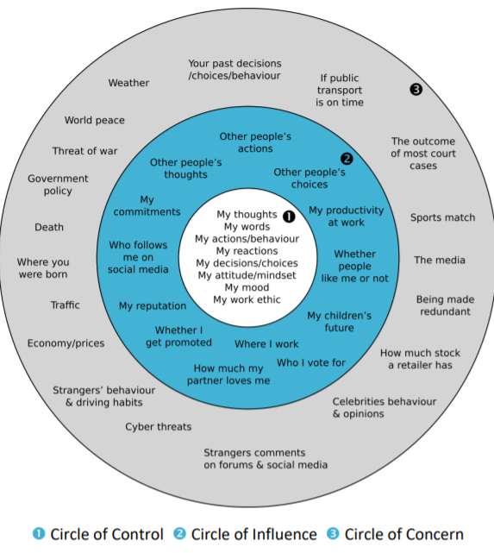
Mindset Lesson for the Day
When You Are Able To master Your Senses, You Will Master Your Life

Slide 4
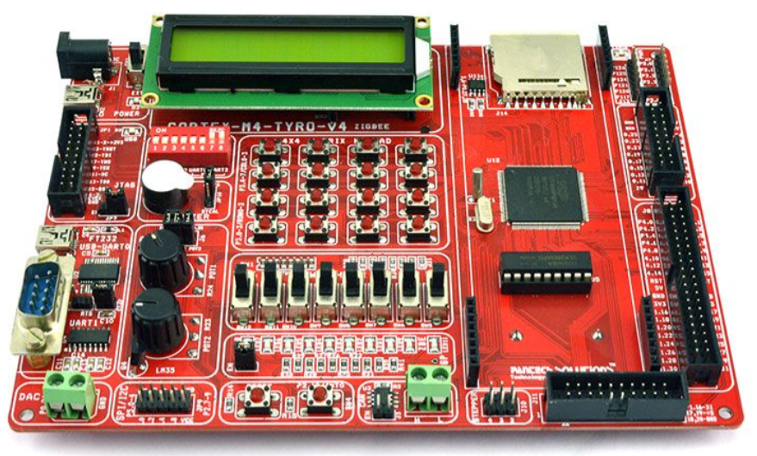
Embedded Sytem Design using Cortex M4-LPC4088

Slide 5
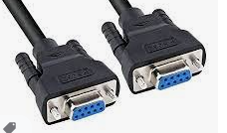
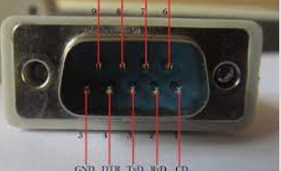
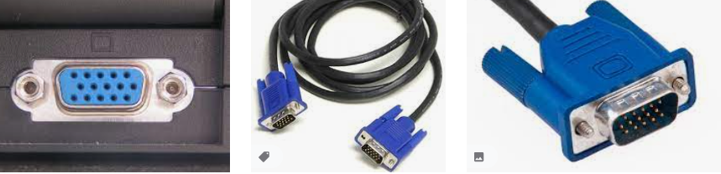
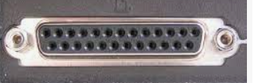
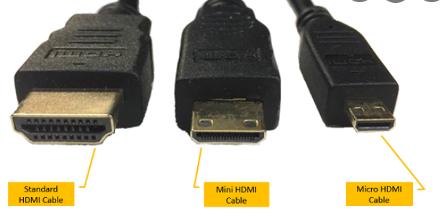
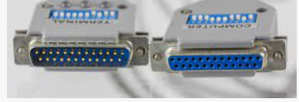
Types of Connectors
RS232
VGA
HDMI
PARALLEL PORT

Slide 6
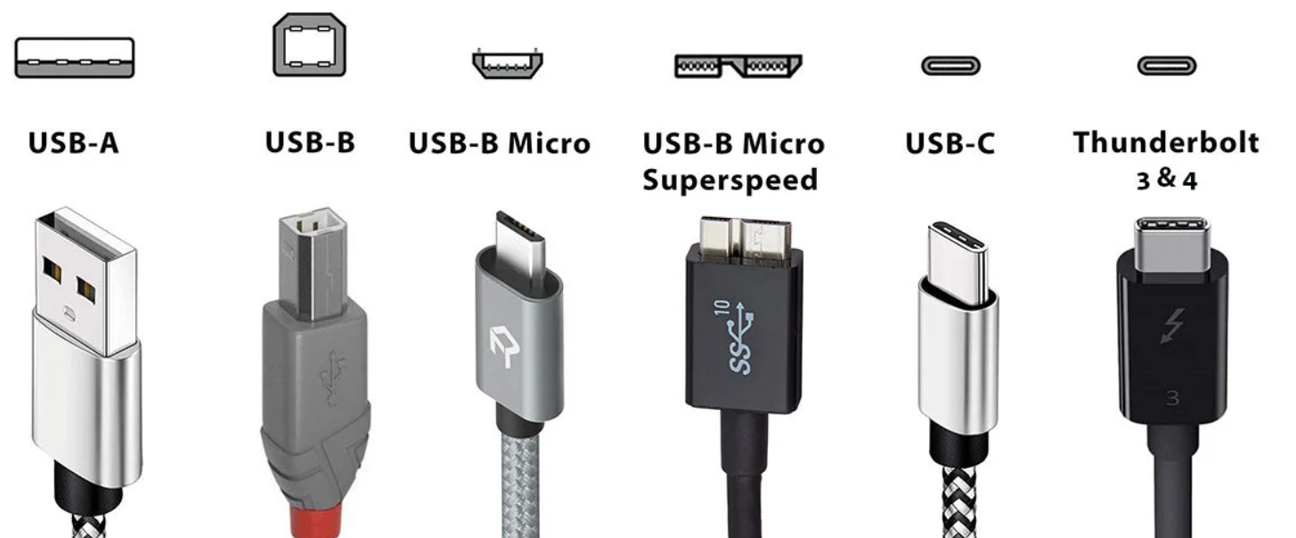
Types of USB Connectors

Slide 7
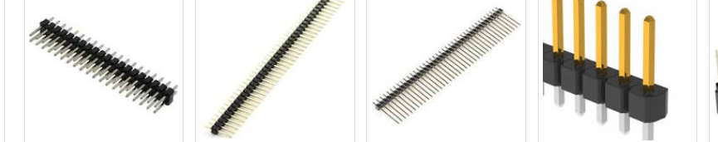
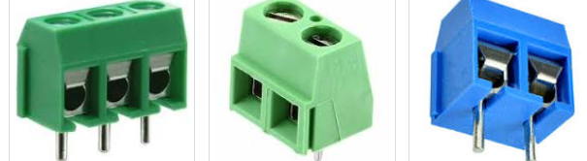
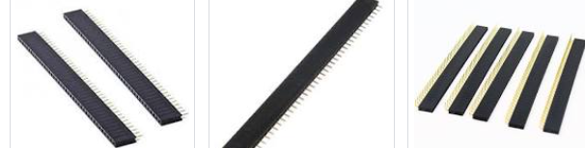
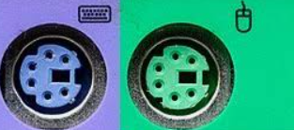
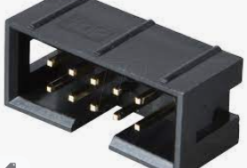
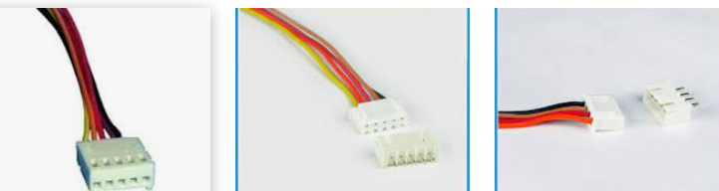
Connectors
PCB TERMINAL BLOCK CONNECTORS
Berg strips –Male and Female
PS2 Connectors
BOX Connectors
RMC Connectors

Slide 8
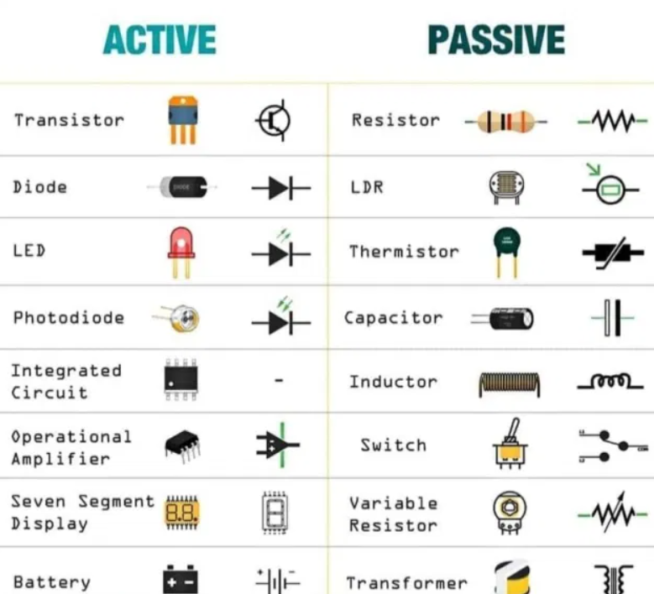
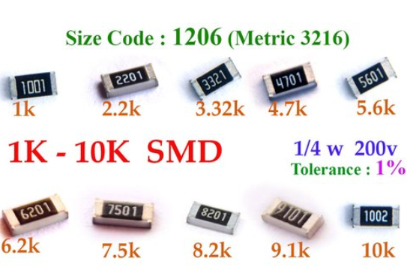
Active & Passive Components

Slide 9
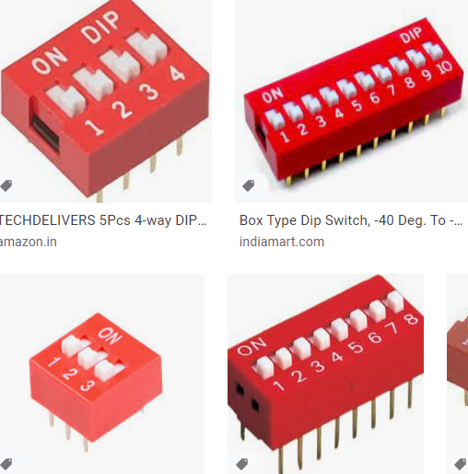
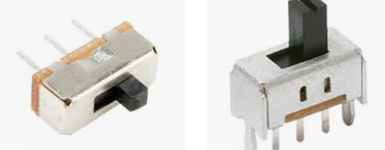
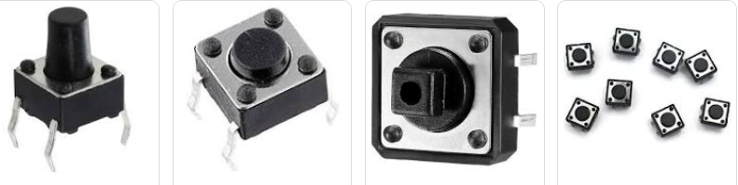
Switches
Slide Switch
DIP Switch
Tactile push button switch

Slide 10
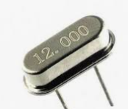
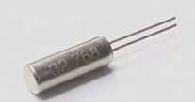
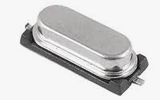
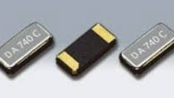
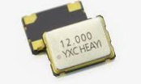
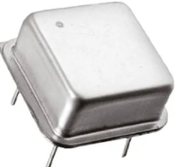
Crystal and Oscillator

Slide 11
LPC4088 –Cortex M4
The Cortex-M4 processor is a high-performance 32-bit processor with a 3-stage pipeline
Harvard architecture with separate local instruction and data buses, as well as a third bus
with slightly lower performance for peripherals.
The Cortex-M4 uses the Thumb® instruction set, providing high code density and reduced program memory requirements.
The Cortex-M4 CPU also includes an internal prefetch unit that supports speculative branches.
The LPC408x/407x is targeted to operate at up to a 120 MHz CPU frequency under worst case commercial conditions

Slide 12
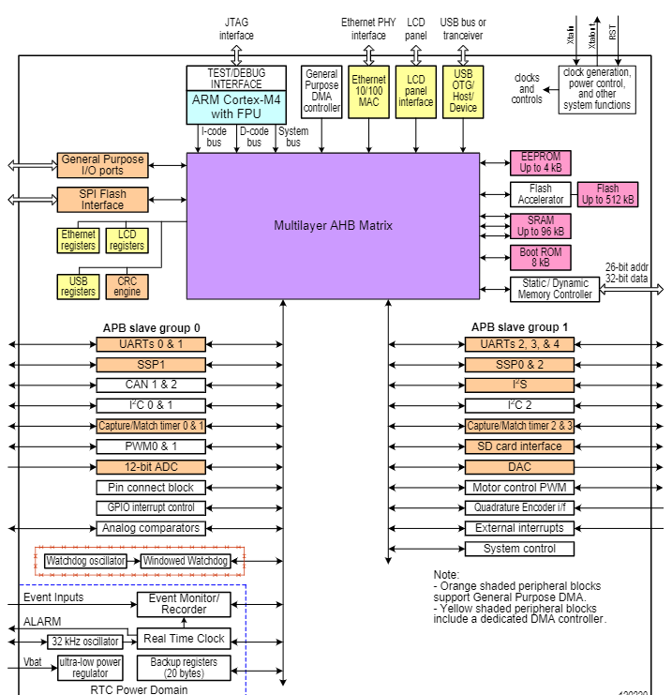
LPC4088 BLOCK DIAGRAM

Slide 13
ARM CORTEX M4 Features
running at frequencies of up to 120 MHz
Memory Protection Unit (MPU)
Nested Vectored Interrupt Controller (NVIC)
Hardware floating-point unit (not all versions)
Non-maskable Interrupt (NMI) input
JTAG and Serial Wire Debug (SWD)
Embedded Trace Macrocell (ETM)
System tick timer
Memory
up to 512 kB on-chip Flash (ISP and IAP capabilities)
up to 96 kB on-chip SRAM includes
up to 4032 byte on-chip EEPROM

Slide 14
LCD controller (not all versions)
External Memory Controller (EMC) (not all versions)
General Purpose DMA controller (GPDMA)
Serial interfaces
Quad SPI Flash Interface (SPIFI)
Ethernet MAC with MII/RMII interface (not all versions)
USB 2.0 full-speed dual port device/host/OTG controller (not all versions)
up to 5 UARTs
3 SSP controllers
I2S (Inter-IC Sound) interface
CAN controller with 2 channels
Digital peripherals
SD/MMC memory card interface (not all versions)
Up to 165 General Purpose I/O (GPIO) pins
4 general purpose timers/counters
Quadrature encoder interface (not all versions)
2 standard PWM/timer blocks
One motor control PWM
Real-Time Clock (RTC)
Event Recorder
Windowed Watchdog Timer (WWDT)
CRC Engine block

Slide 15
Analog peripherals
- 12-bit Analog-to-Digital Converter (ADC)
- 10-bit Digital-to-Analog Converter (DAC)
- 2 analog comparators (not all versions)
Power control
- 4 reduced power modes (Sleep, Deep-sleep, Power-down, Deep power-down)
- Brownout detect with separate threshold
- On-chip Power-On Reset (POR).
Clock generation
Clock output function that can reflect various clocks
On-chip crystal oscillator (1 MHz to 25 MHz)
12 MHz Internal RC oscillator (IRC)
on-chip PLL allows CPU operation up to the max. CPU rate
dedicated PLL may be used for USB interface

Slide 16
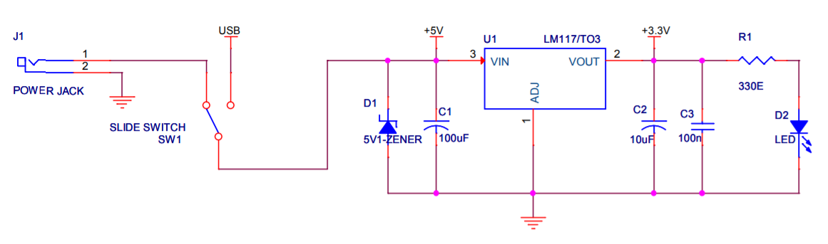
Power Supply Design

Slide 17
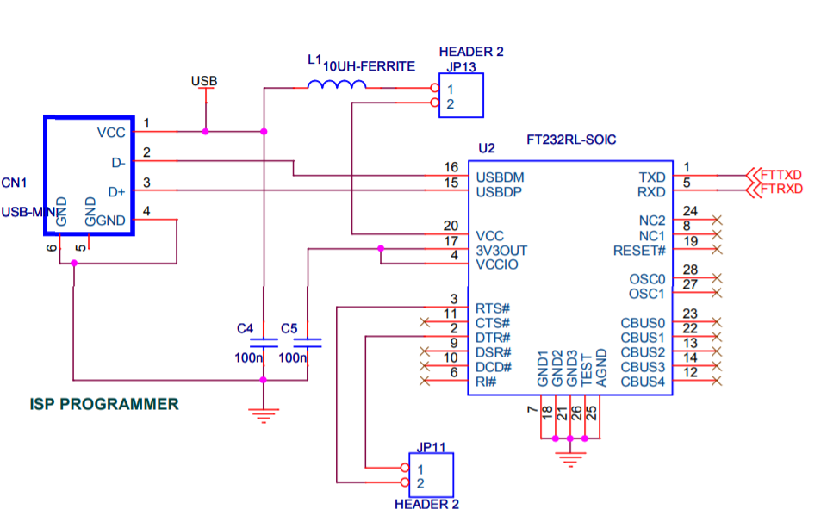
FT232 Interface and ISP Programming

Slide 18
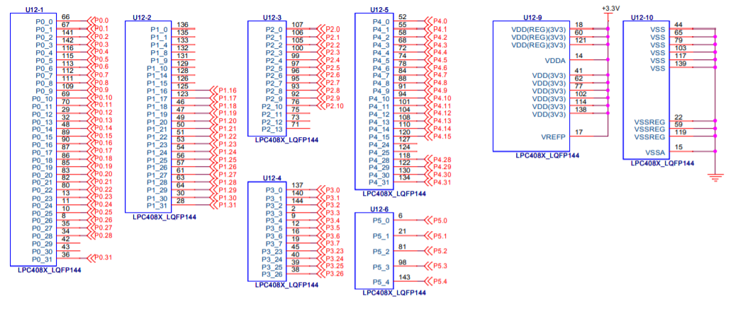
LPC4088

Slide 19
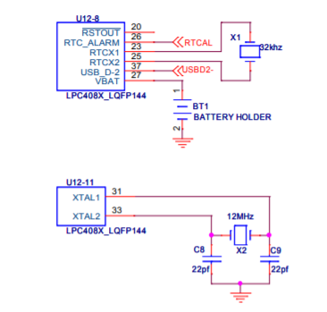
Crystal

Slide 20
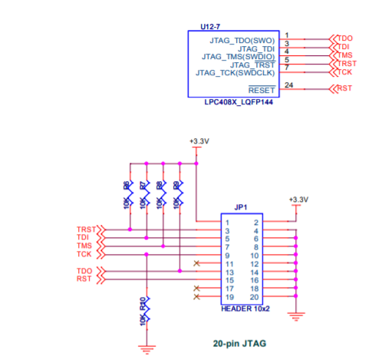
JTAG

Slide 21
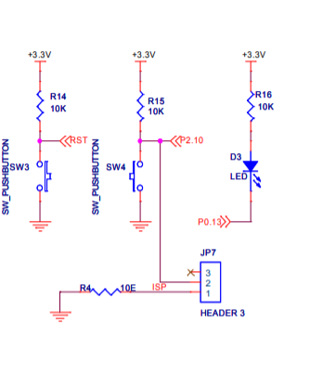
Reset and Interrupt

Slide 22
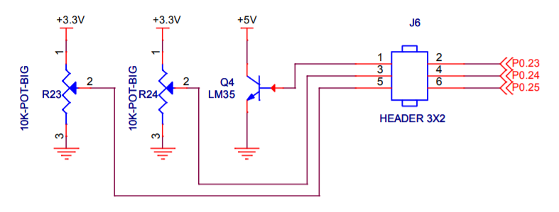
ADC Interface

Slide 23
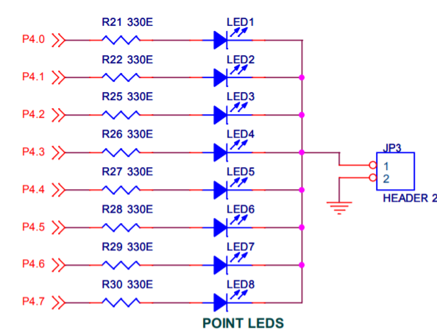
LED Interface

Slide 24
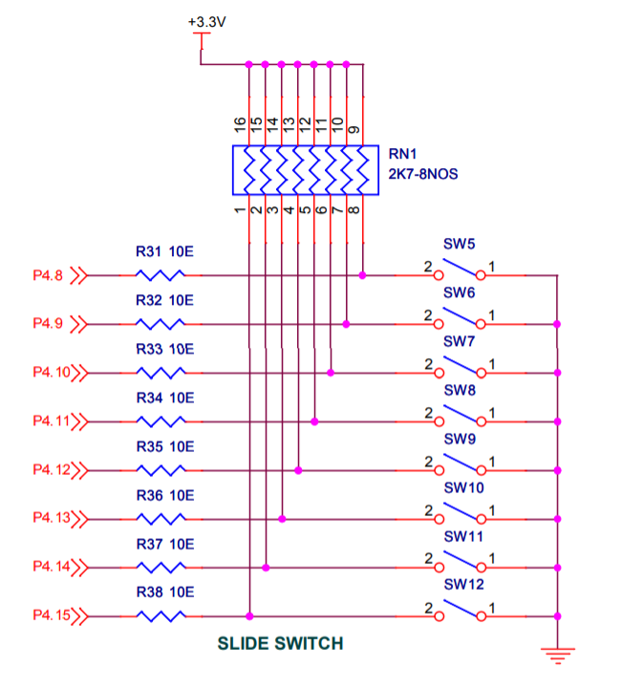
Slide Switch Interface

Slide 25
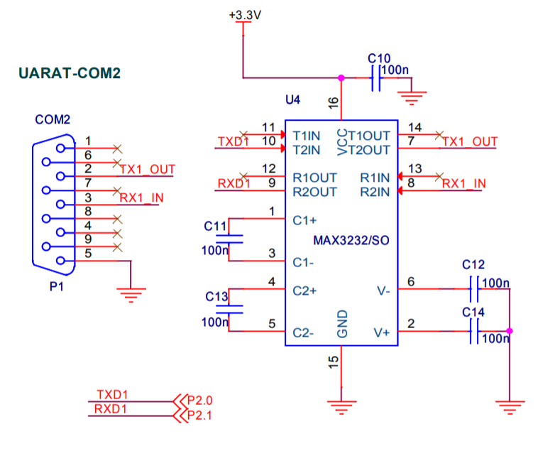
RS232 Interface

Slide 26
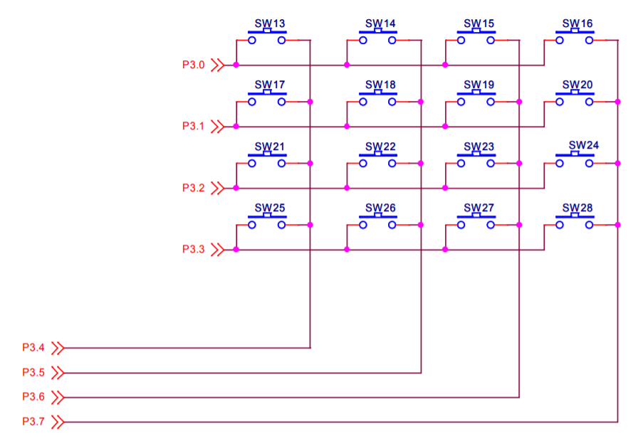
Keypad Interface

Slide 27
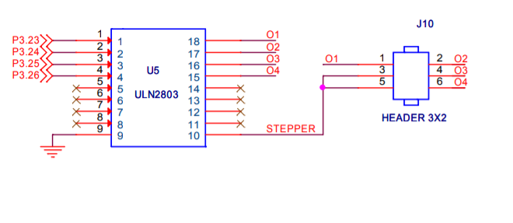
Stepper Motor Interface

Slide 28
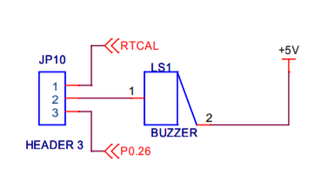
Buzzer Interface

Slide 29
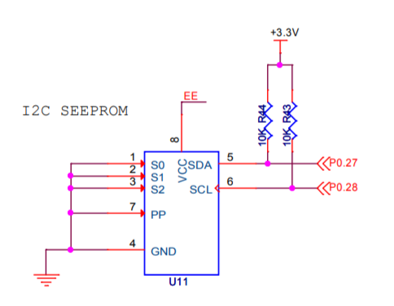
I2C EEPROM

Slide 30
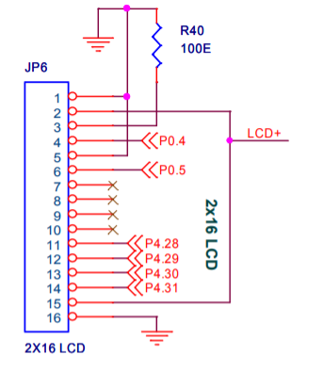
LCD Interface

Slide 31
LED Blinking demo
#include "LPC407x_8x_177x_8x.h"
void delay_ms(long ms);
int main(void)
{
//1. Set the PCGPIO bit
LPC_SC->PCONP |= (1<<15);
//2. Configure pins P4.0 to P4.7 as GPIO pins
LPC_IOCON->P4_0 = 0;
LPC_IOCON->P4_1 = 0;
LPC_IOCON->P4_2 = 0;
LPC_IOCON->P4_3 = 0;
LPC_IOCON->P4_4 = 0;
LPC_IOCON->P4_5 = 0;
LPC_IOCON->P4_6 = 0;
LPC_IOCON->P4_7 = 0;
//3. Configure the pins P4.0 to P4.7 as output
LPC_GPIO4->DIR= 0xFF;
while(1)
{
//4. Send a High
LPC_GPIO4->PIN= 0xFF;
//5.Pause the system for few milliseconds
delay_ms(500);
//6.Send a low
LPC_GPIO4->PIN= 0x00;
//7.Pause the system for few milliseconds
delay_ms(500);
}
}

Slide 32
Delay
void delay_ms(long ms) // delay 1 ms per count @ CCLK 120 MHz
{
long i,j;
for (i = 0; i < ms; i++ )
for (j = 0; j < 26659; j++ );
}

Slide 33
Thank You

